Slide 1
The Software Testing Pyramid: A Concrete Example
Jim Weaver
Vanderbilt University Medical Center
(weaver.je@gmail.com)
Source Code and Tests
https://github.com/weaverj/testpyramidexample

Slide 2
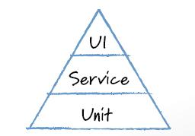
Mike Cohn’s Test Pyramid
Automated tests at three levels.
Foundational base of unit tests.
Minimum necessary tests through user interface.
Service testing in the middle – testing services provided by the application independent of the UI.

Slide 3
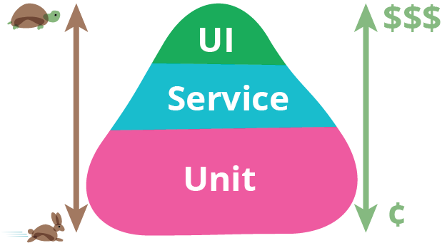
Motivations
Many teams observed with high percentage of automated tests through the UI.
UI tests are slower, more brittle, expensive.
Unit tests are easy for developers to write, usually in same language as application.
Application logic can be tested independent of UI in Service level tests - few teams observed doing this.

Slide 4
The Three Layers of the Pyramid
 | Unit | Service | UI
Appropriate Purpose | Test Units of Code, Aid with Design and Code Quality | Test Business Logic / Services | Test the User Interface
Authors | Developers | Customers and Developers | QA automation or Developers
Speed / Cost | Fast / Low | Fast to Medium / Medium | Slow / High
Orthagonal Concepts: Integration Tests, End to End tests. Decide what the above layers mean to your team.

Slide 5
Challenges
Team must have a shared understanding of the purpose of the various test layers.
Decisions must be made as to what parts of a feature to test how and in each layer.
Customer participation with service level tests may be hard to obtain.
Communication issues between different test authors resulting in duplication or gaps.

Slide 6
Test Pyramid For a Prescribing Application Feature
Examine how a team distributed tests for a feature of a real medication prescribing application.
Discuss process, team composition, technical tools used.
Look at and run working code and tests in the various layers in a demo application based on the production prescribing application.
Prescribing Application is a web-based application with a rich front-end with most business logic implemented on back-end server.

Slide 7
Prescribing Feature: Limit Opiate Rx Duration

Slide 8
Planning

Slide 9
Tasks / Tests

Slide 10
Service Tests

Slide 11
Unit Tests / Implementation

Slide 12
UI Tests

Slide 13
Summary

Slide 14
References

